Slide 1
Deploy WordPress application
In AWS using RDS

Slide 2
WordPress Overview :
What is WordPress?
Benefits of WordPress
How to Install

Slide 3

What is wordpress ?
WordPress is highly customizable, and has literally thousands of plugin pieces of software so you can use your site for just about anything.
If you're ever curious about who uses WordPress, head on over to the WordPress site showcase and you'll be impressed by the number of well-known sites and famous people using WordPress to power their websites.

Slide 4
Benefits of WordPress :
Software is free.
Easy to use
Control is in your hand
Very large community support

Slide 5
Steps to install wordpress :
Create two servers (public and private)
Connect to the public server, through public server connect private server
using bastion host.
Now install the MySQL in private server and create a user and change the privileges to that user.
Now come back to public server ,here also install MySQL ,PHP ,php-mysql.
Then download the WordPress package in public sever and unzip it .
After completion of above process we will get folder called WordPress go to inside that folder and find wp-congig-smaple.php file ,copy or rename that file to wp-config.php.
After that edit that file add the credential like
DB name
DB User
DB Password
DB HOST
After that add the WordPress keys.

Slide 6
Then install the HTTPD server in public machine .
Start & Enable the HTTPD server.
Go to EC2 console select the public server and add the HTTPD port number in security groups.
Now copy the public IP and browse the IP along with post number.
Now you will be able to see below page.

Slide 7
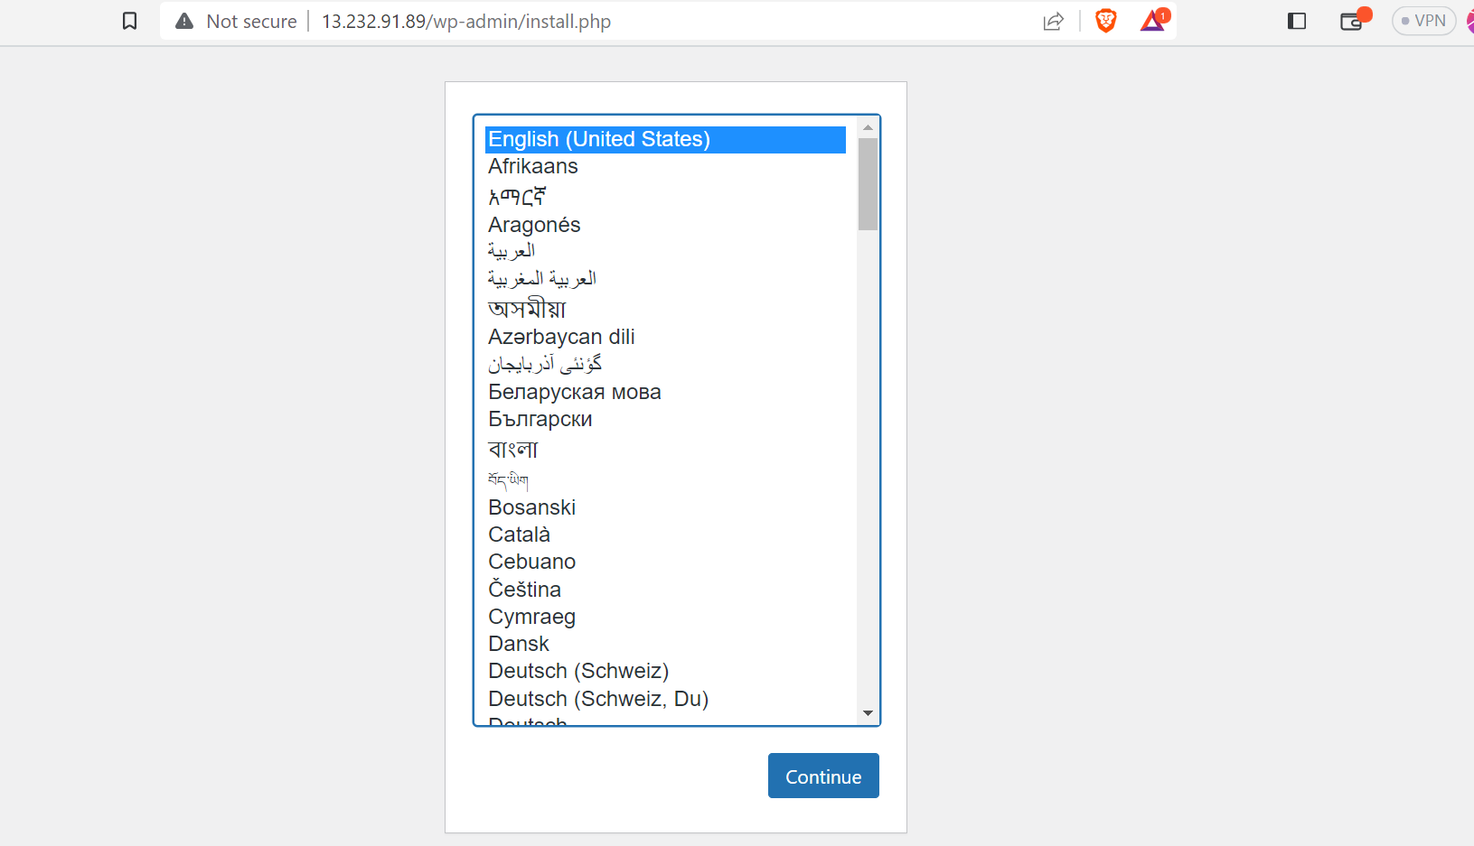
Output :

Slide 8
Thank you.

